Slide 1
Data Preprocessing
Data Cleaning, DATA INEGRATION and DATA REDUCTION

Slide 2
Major Tasks in Data Preprocessing
Data cleaning
Fill in missing values, smooth noisy data, identify or remove outliers, and resolve inconsistencies
Data integration
Integration of multiple databases, data cubes, or files
Data reduction
Dimensionality reduction
Numerosity reduction
Data compression
Data transformation and data discretization (will be covered in next lectures)
Normalization
Concept hierarchy generation

Slide 3
Data Cleaning

Slide 4
Data Cleaning
Data in the Real World Is Dirty: Lots of potentially incorrect data, e.g., instrument faulty, human or computer error, transmission error
incomplete: lacking attribute values, lacking certain attributes of interest, or containing only aggregate data
e.g., Occupation=“ ” (missing data)
noisy: containing noise, errors, or outliers
e.g., Salary=“−10” (an error)
inconsistent: containing discrepancies in codes or names, e.g.,
Age=“42”, Birthday=“03/07/2010”
Was rating “1, 2, 3”, now rating “A, B, C”
Intentional (e.g., disguised missing data)
Jan. 1 as everyone’s birthday

Slide 5
Incomplete (Missing) Data
Data is not always available
E.g., many tuples have no recorded value for several attributes, such as customer income in sales data
Missing data may be due to
equipment malfunction
inconsistent with other recorded data and thus deleted
data not entered due to misunderstanding
certain data may not be considered important at the time of entry
Missing data may need to be inferred

Slide 6
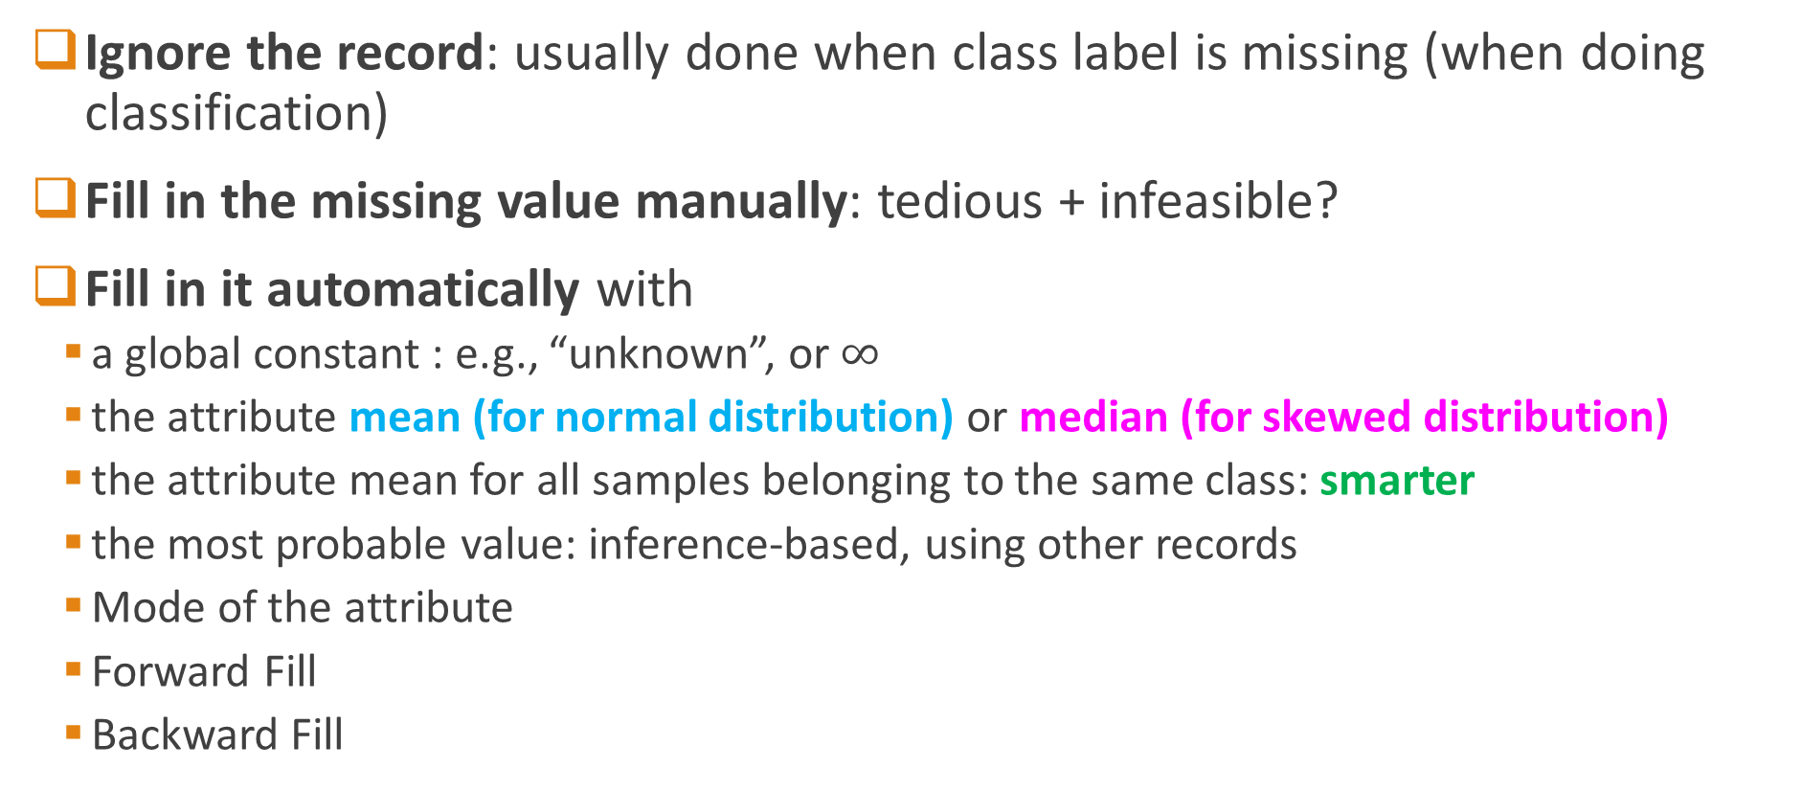
How to Handle Missing Data?
Ignore the record: usually done when class label is missing (when doing classification)
Fill in the missing value manually: tedious + infeasible?
Fill in it automatically with
a global constant : e.g., “unknown”, or $∞$
the attribute mean (for normal distribution) or median (for skewed distribution)
the attribute mean for all samples belonging to the same class: smarter
the most probable value: inference-based, using other records
Mode of the attribute
Forward Fill
Backward Fill
Not foolproof

Slide 7
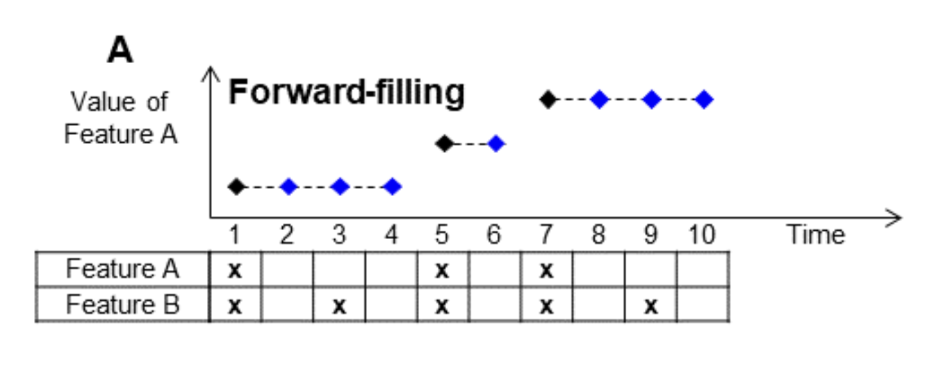
Forward Filling

Slide 8
Noisy Data
Noise: random error or variance in a measured variable
Incorrect attribute values may be due to:
faulty data collection instruments
data entry problems
data transmission problems
technology limitation
inconsistency in naming convention
Other data problems which require data cleaning
duplicate records
incomplete data
inconsistent data

Slide 9
How to Handle Noisy Data?
Binning
first sort data and partition into (equal-frequency) bins
then one can smooth by bin means, smooth by bin median, smooth by bin boundaries, etc.
Regression
smooth by fitting the data into regression functions
Clustering
detect and remove outliers
Combined computer and human inspection
detect suspicious values and check by human (e.g., deal with possible outliers)
Outlier analysis

Slide 10
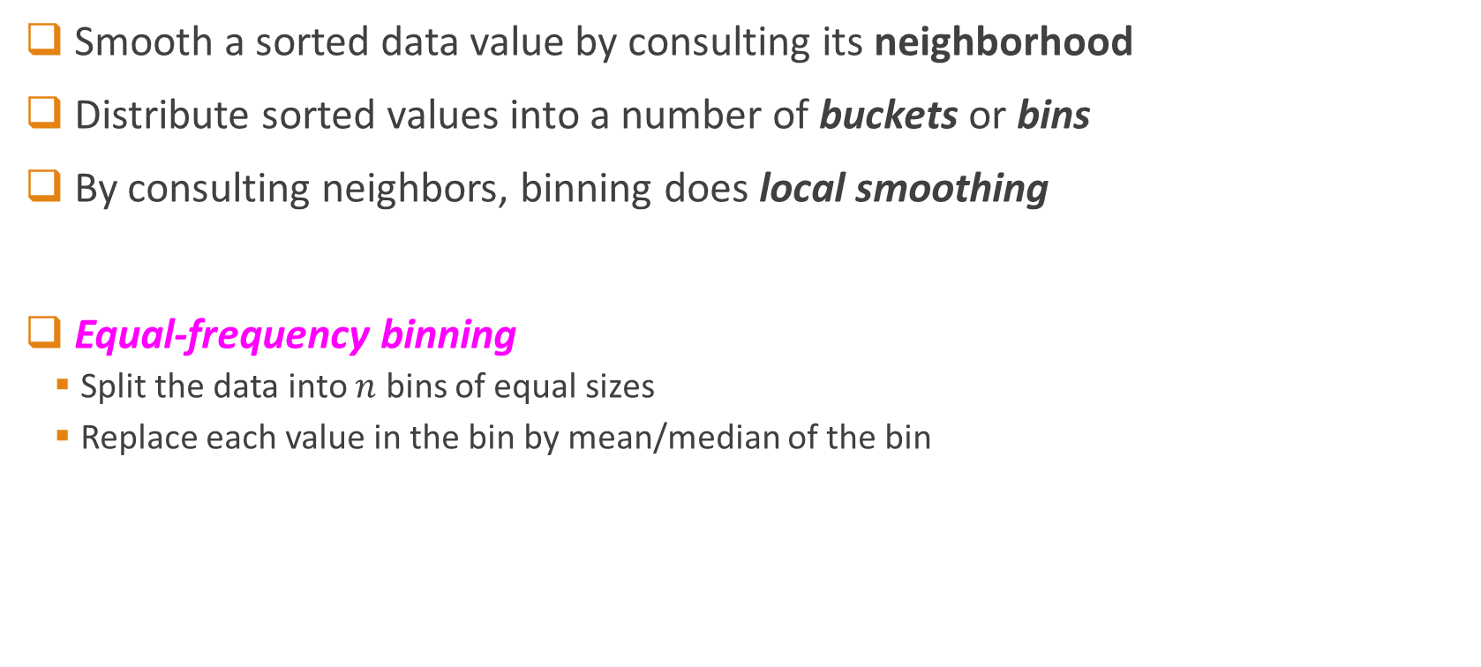
Binning
Smooth a sorted data value by consulting its neighborhood
Distribute sorted values into a number of buckets or bins
By consulting neighbors, binning does local smoothing
Equal-frequency binning
Split the data into $n$ bins of equal sizes
Replace each value in the bin by mean/median of the bin

Slide 11
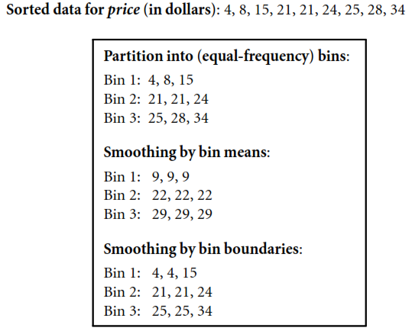
Smoothing by Bin Means
How to do that?

Slide 12



Smoothing by Bin Boundaries
Identify $min$ and $max$ of a bin
Replace each bin value by closet value
Note: Binning can also be used as discretization technique. More on that in later lectures…
$$\left|4−15\right|=11$$
$$\left|4−8\right|=4$$

Slide 13
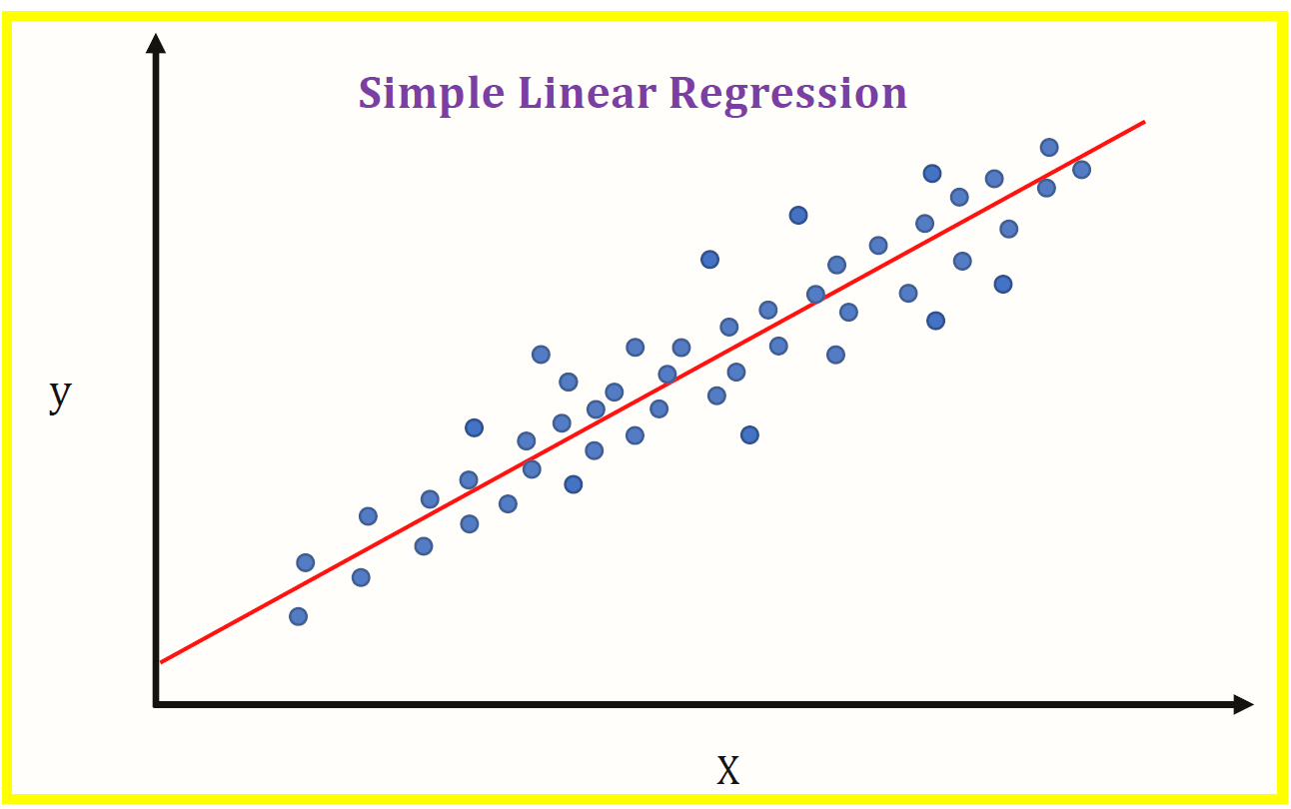
Smoothing by Regression
In linear regression, we find the “best” line to fit two attributes
So the one attribute can be used to predict the other!

Slide 14
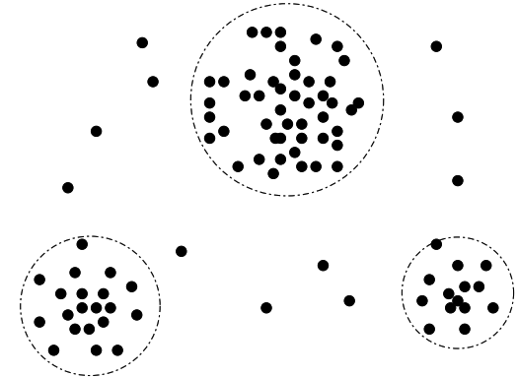
Outlier Analysis
Clustering

Slide 15
Data Integration

Slide 16
Data Integration
Merging of data from multiple sources
Can introduce redundancies and inconsistencies
Schema integration: e.g., A.cust-id or B.cust-#
Integrate metadata from different sources
Entity identification problem:
How can equivalent real-world entities from multiple data sources be matched up?
Detecting and resolving data value conflicts
For the same real world entity, attribute values from different sources are different
Possible reasons: different representations, different scales, e.g., metric vs. British units
Make the data coherent…

Slide 17
Handling Redundancy in Data Integration
Redundant data occur often when integration of multiple databases
Object identification: The same attribute or object may have different names in different databases
Derivable data: One attribute may be a “derived” attribute in another table, e.g., annual revenue from quarterly revenue
Redundant attributes may be able to be detected by correlation analysis and covariance analysis
Careful integration of the data from multiple sources may help reduce/avoid redundancies and inconsistencies and improve mining speed and quality

Slide 18
Correlation Analysis (Nominal Data)
Χ² (chi-square) test
The larger the Χ² value, the more likely the variables are related
The cells that contribute the most to the Χ² value are those whose actual count is very different from the expected count
Correlation does not imply causality
# of hospitals and # of car-theft in a city are correlated
Both are causally linked to the third variable: population

Slide 19
Chi-Square Calculation: An Example
Χ² (chi-square) calculation (numbers in parenthesis are expected counts calculated based on the data distribution in the two categories)
It shows that like_science_fiction and play_chess are correlated in the group
 | Play chess | Not play chess | Sum (row)
Like science fiction | 250(90) | 200(360) | 450
Not like science fiction | 50(210) | 1000(840) | 1050
Sum(col.) | 300 | 1200 | 1500

Slide 20
Correlation Analysis (Numeric Data)
Correlation coefficient (also called Pearson’s product moment coefficient)
where n is the number of tuples, and are the respective means of A and B, σ_{A} and σ_{B} are the respective standard deviation of A and B, and Σ(a_{i}b_{i}) is the sum of the AB cross-product.
If r_{A,B} > 0, A and B are positively correlated (A’s values increase as B’s). The higher, the stronger correlation.
r_{A,B} = 0: independent; r_{AB} < 0: negatively correlated

Slide 21
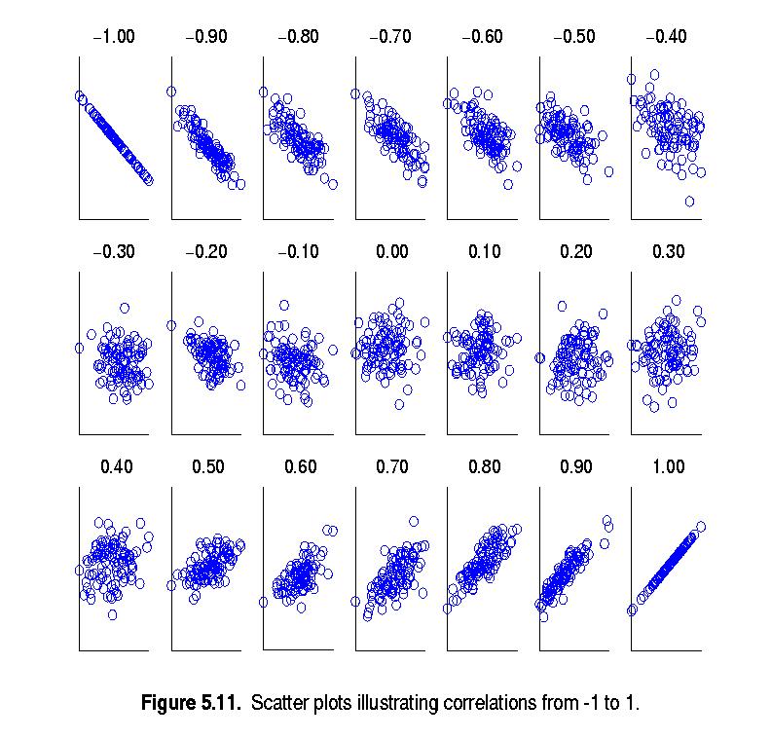
Visually Evaluating Correlation
Scatter plots showing the similarity from –1 to 1.

Slide 22
Correlation (viewed as linear relationship)
Correlation measures the linear relationship between objects
To compute correlation, we standardize data objects, A and B, and then take their dot product

Slide 23
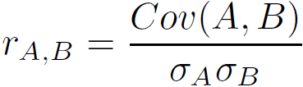
Covariance (Numeric Data)
Covariance is similar to correlation
where n is the number of tuples, and are the respective mean or expected values of A and B, σ_{A} and σ_{B} are the respective standard deviation of A and B.
Positive covariance: If Cov_{A,B} > 0, then A and B both tend to be larger than their expected values.
Negative covariance: If Cov_{A,B} < 0 then if A is larger than its expected value, B is likely to be smaller than its expected value.
Independence: Cov_{A,B} = 0 but the converse is not true:
Some pairs of random variables may have a covariance of 0 but are not independent. Only under some additional assumptions (e.g., the data follow multivariate normal distributions) does a covariance of 0 imply independence
Correlation coefficient:

Slide 24

Co-Variance: An Example
It can be simplified in computation as
Suppose two stocks A and B have the following values in one week: (2, 5), (3, 8), (5, 10), (4, 11), (6, 14).
Question: If the stocks are affected by the same industry trends, will their prices rise or fall together?
E(A) = (2 + 3 + 5 + 4 + 6)/ 5 = 20/5 = 4
E(B) = (5 + 8 + 10 + 11 + 14) /5 = 48/5 = 9.6
Cov(A,B) = (2×5+3×8+5×10+4×11+6×14)/5 − 4 × 9.6 = 4
Thus, A and B rise together since Cov(A, B) > 0.

Slide 25
Data Reduction

Slide 26
Data Reduction
Obtain a reduced representation of the data set that is much smaller in volume but yet produces the same (or almost the same) analytical results.
Why data reduction?
A database/data warehouse may store terabytes of data. Complex data analysis may take a very long time to run on the complete data set.

Slide 27
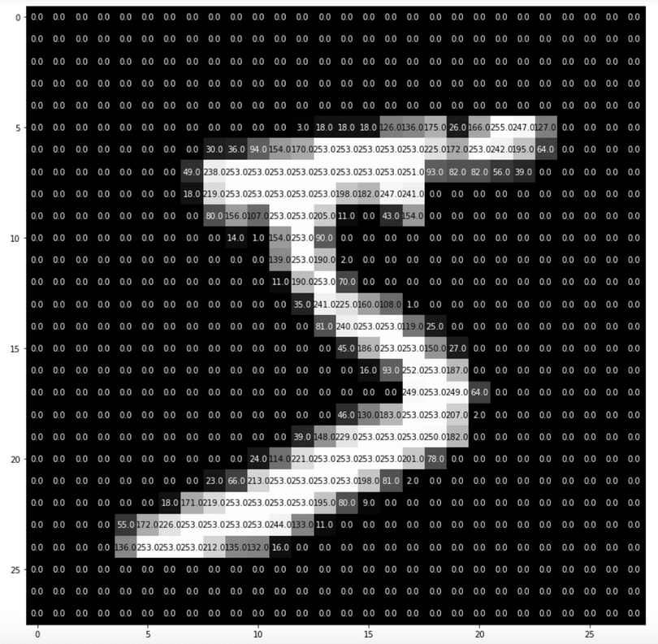
Data Reduction
Recall this image example from lecture 2
0 | 0 | … | 255 | 253 | 252 | … | 0 | 0 | 0
Is it necessary to have all the dimensions to preserve the information this image contains?

Slide 28
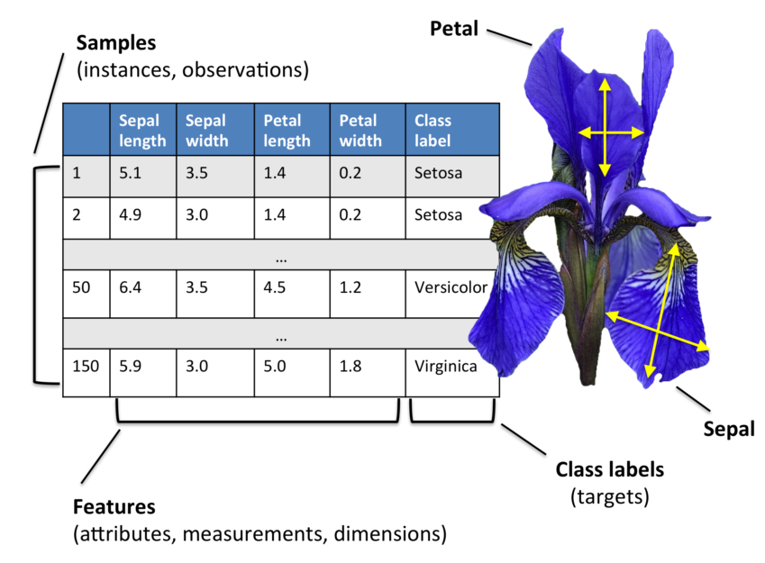
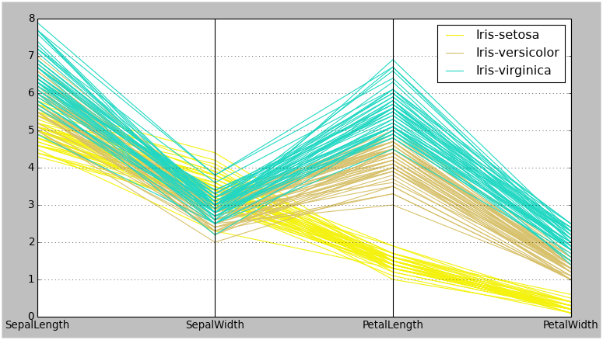
Data Reduction
Is it necessary to have all the dimensions to preserve the information this image contains?
Recall from Lecture 6
Is it necessary store all the records?

Slide 29
Data Reduction Strategies
Numerosity reduction (some simply call it: Records Reduction)
Regression Models
Histograms, clustering, sampling
Dimensionality reduction: Remove unimportant dimensions
Wavelet transforms
Principal Components Analysis (PCA)
Feature subset selection, feature creation
Data compression

Slide 30
Data Reduction: Numerosity Reduction
Reduce data volume by choosing alternative, smaller forms of data representation
Parametric methods (e.g., regression)
Assume the data fits some model, estimate model parameters, store only the parameters, and discard the data (except possible outliers)
Example: Fit a Linear Regression model, store only that model to find the value of Y given the value X
Non-parametric methods
Do not assume models
Histograms, clustering, sampling, …

Slide 31

Parametric Data Reduction: Regression
Linear regression $(Y = w X + b)$
Data modeled to fit a straight line
Save parameters and discard one attribute
Multiple regression $(Y = b_{0} + b_{1} X_{1} + b_{2} X_{2})$
Allows a response variable Y to be modeled as a linear function of multidimensional feature vector
Y1
Y1’
y = x + 1
X1
x

Slide 32
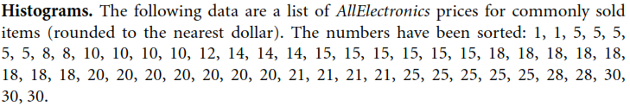
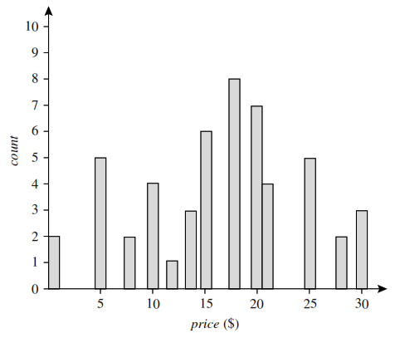
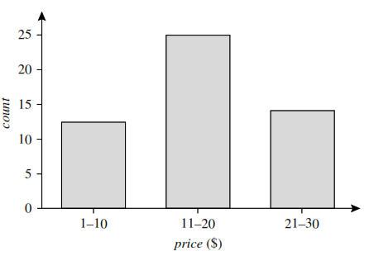
Non-Parametric Data Reduction: Histogram
Equal-width Histogram

Slide 33
Non-Parametric Data Reduction: Clustering
Partition data set into clusters based on similarity, and store cluster representation (e.g., centroid and diameter) only
Can be very effective if data is naturally clustered but not if data is “smeared”
There are many choices of clustering definitions and clustering algorithms
Cluster analysis will be studied in future lectures

Slide 34
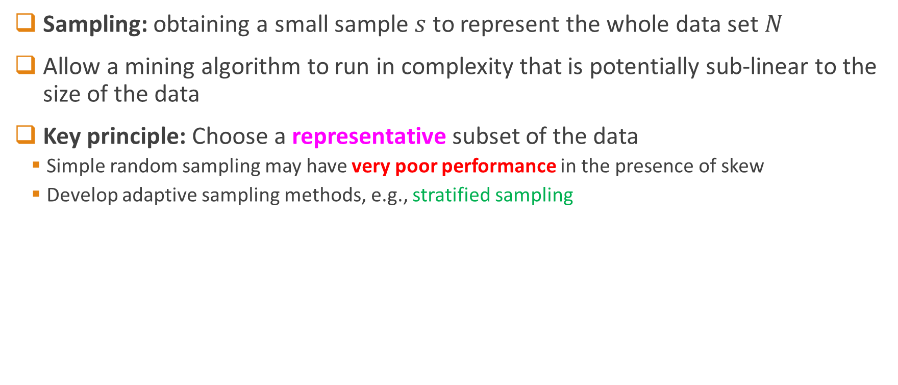
Non-Parametric Data Reduction: Sampling
Sampling: obtaining a small sample $s$ to represent the whole data set $N$
Allow a mining algorithm to run in complexity that is potentially sub-linear to the size of the data
Key principle: Choose a representative subset of the data
Simple random sampling may have very poor performance in the presence of skew
Develop adaptive sampling methods, e.g., stratified sampling

Slide 35
Types of Sampling
Simple random sampling
There is an equal probability of selecting any particular item
Sampling without replacement
Once an object is selected, it is removed from the population
Sampling with replacement
A selected object is not removed from the population
SRSWOR
(simple random
sample without
replacement)
SRSWR
Raw Data

Slide 36
Types of Sampling
Stratified sampling:
Partition the data set, and draw samples from each partition (proportionally, i.e., approximately the same percentage of the data)
Used in conjunction with skewed data
Also useful for Train/Test splits of the data

Slide 37
Data Reduction: Data Compression
String compression
There are extensive theories and well-tuned algorithms
Typically lossless, but only limited manipulation is possible without expansion
Audio/video compression
Typically lossy compression, with progressive refinement
Sometimes small fragments of signal can be reconstructed without reconstructing the whole
Original Data
Compressed
Data
lossless
Original Data
Approximated
lossy

Slide 38
Data Reduction: Dimensionality Reduction
Curse of dimensionality
When dimensionality increases, data becomes increasingly sparse
Density and distance between points, which is critical to clustering, outlier analysis, becomes less meaningful
Dimensionality reduction
Avoid the curse of dimensionality
Help eliminate irrelevant features and reduce noise
Reduce time and space required in data mining
Allow easier visualization
Dimensionality reduction techniques
Principal Component Analysis (Unsupervised)
Feature Selection (Supervised)

Slide 39
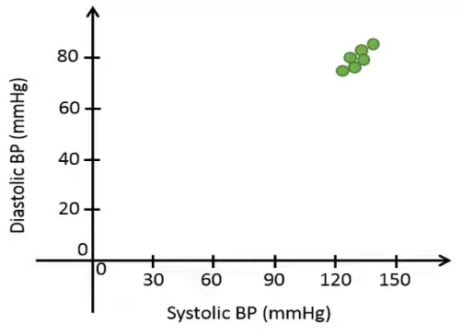
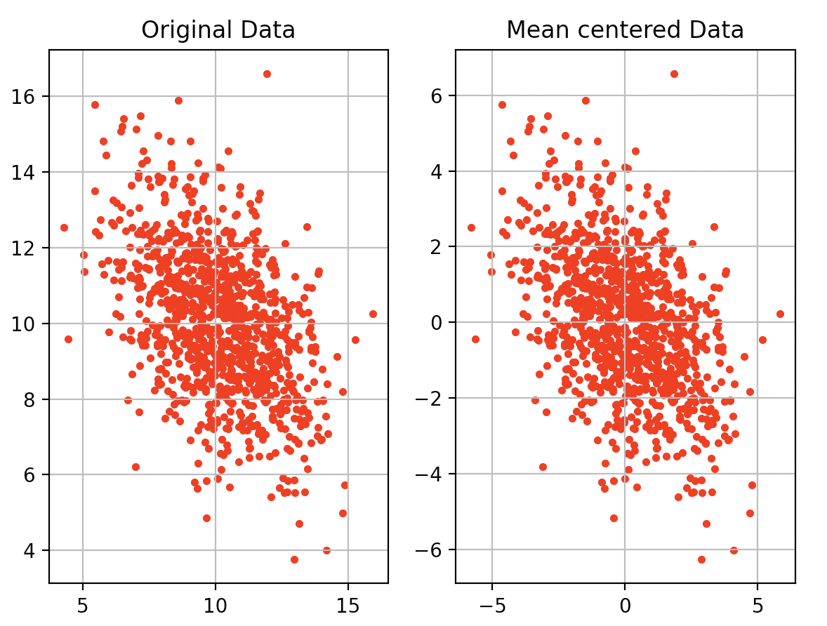
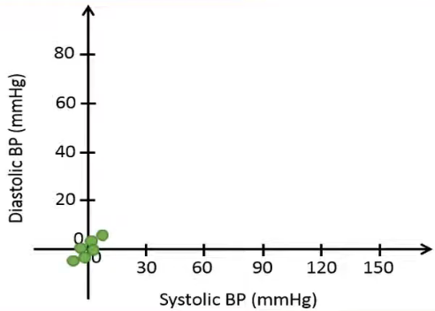
Principal Component Analysis
First thing first: What happens if you subtract mean from the data?

Slide 40
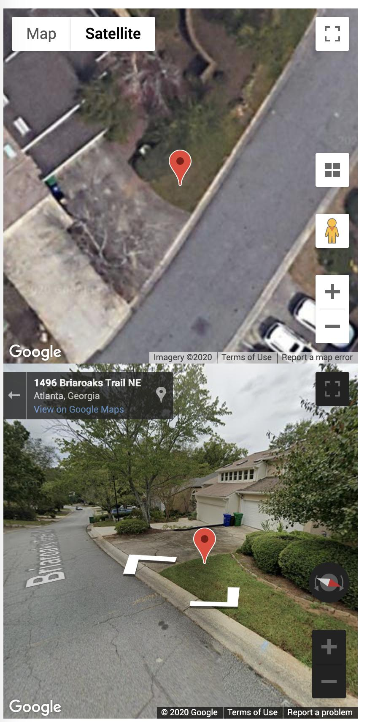
Principal Component Analysis
Second: What happens if we observe the data using different rotations?
Observation: Observing the data from different rotation gives you different amount of information!

Slide 41
Data Transformation
A function that maps the entire set of values of a given attribute to a new set of replacement values s.t. each old value can be identified with one of the new values
Methods
Smoothing: Remove noise from data
Attribute/feature construction
New attributes constructed from the given ones
Aggregation: Summarization, data cube construction
Normalization: Scaled to fall within a smaller, specified range
min-max normalization
z-score normalization
normalization by decimal scaling
Discretization: Concept hierarchy climbing
Notes:
41

Slide 42
Normalization
Min-max normalization: to [new_min_{A}, new_max_{A}]
Ex. Let income range $12,000 to $98,000 normalized to [0.0, 1.0]. Then $73,000 is mapped to
Z-score normalization (μ: mean, σ: standard deviation):
Ex. Let μ = 54,000, σ = 16,000. Then
Normalization by decimal scaling
Where j is the smallest integer such that Max(|ν’|) < 1

Slide 43
Discretization
Three types of attributes
Nominal—values from an unordered set, e.g., color, profession
Ordinal—values from an ordered set, e.g., military or academic rank
Numeric—real numbers, e.g., integer or real numbers
Discretization: Divide the range of a continuous attribute into intervals
Interval labels can then be used to replace actual data values
Reduce data size by discretization
Supervised vs. unsupervised
Split (top-down) vs. merge (bottom-up)
Discretization can be performed recursively on an attribute
Prepare for further analysis, e.g., classification

Slide 44
Data Discretization Methods
Typical methods: All the methods can be applied recursively
Binning
Top-down split, unsupervised
Histogram analysis
Top-down split, unsupervised
Clustering analysis (unsupervised, top-down split or bottom-up merge)
Decision-tree analysis (supervised, top-down split)
Correlation (e.g., χ²) analysis (unsupervised, bottom-up merge)
44
Notes:
44

Slide 45
Simple Discretization: Binning
Equal-width (distance) partitioning
Divides the range into N intervals of equal size: uniform grid
if A and B are the lowest and highest values of the attribute, the width of intervals will be: W = (B –A)/N.
The most straightforward, but outliers may dominate presentation
Skewed data is not handled well
Equal-depth (frequency) partitioning
Divides the range into N intervals, each containing approximately same number of samples
Good data scaling
Managing categorical attributes can be tricky

Slide 46
Binning Methods for Data Smoothing
Sorted data for price (in dollars): 4, 8, 9, 15, 21, 21, 24, 25, 26, 28, 29, 34
* Partition into equal-frequency (equi-depth) bins:
- Bin 1: 4, 8, 9, 15
- Bin 2: 21, 21, 24, 25
- Bin 3: 26, 28, 29, 34
* Smoothing by bin means:
- Bin 1: 9, 9, 9, 9
- Bin 2: 23, 23, 23, 23
- Bin 3: 29, 29, 29, 29
* Smoothing by bin boundaries:
- Bin 1: 4, 4, 4, 15
- Bin 2: 21, 21, 25, 25
- Bin 3: 26, 26, 26, 34

Slide 47
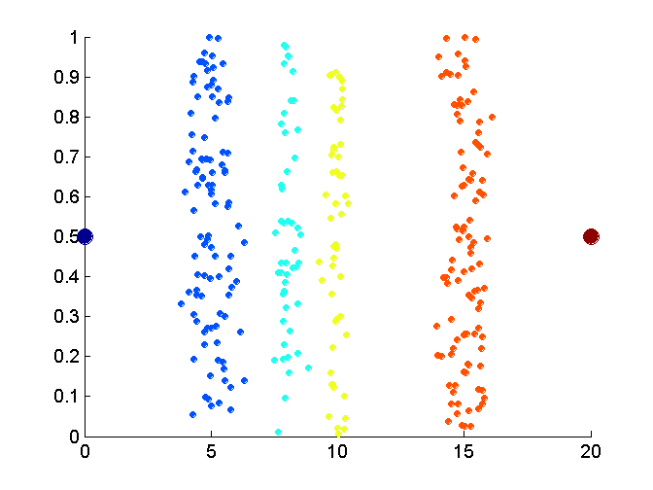
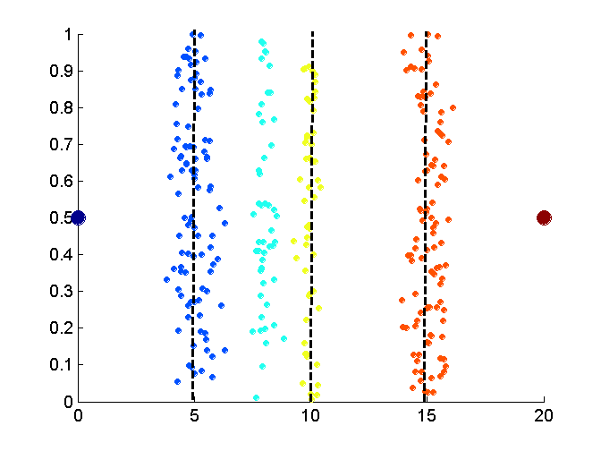
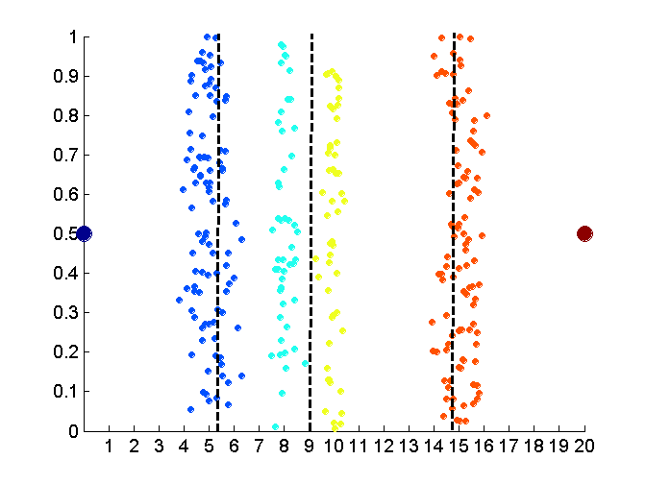
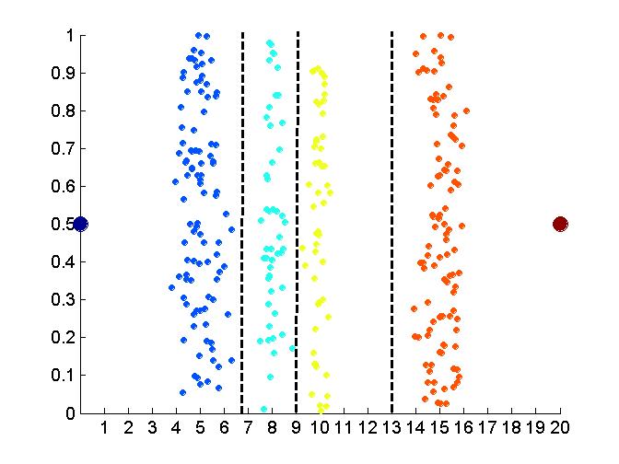
Discretization Without Using Class Labels (Binning vs. Clustering)
Data
Equal interval width (binning)
Equal frequency (binning)
K-means clustering leads to better results
47
Notes:
47

Slide 48
Discretization by Classification & Correlation Analysis
Classification (e.g., decision tree analysis)
Supervised: Given class labels, e.g., cancerous vs. benign
Using entropy to determine split point (discretization point)
Top-down, recursive split
Details to be covered in Chapter 7
Correlation analysis (e.g., Chi-merge: χ²-based discretization)
Supervised: use class information
Bottom-up merge: find the best neighboring intervals (those having similar distributions of classes, i.e., low χ² values) to merge
Merge performed recursively, until a predefined stopping condition
48
Notes:
48

Slide 49
Concept Hierarchy Generation
Concept hierarchy organizes concepts (i.e., attribute values) hierarchically and is usually associated with each dimension in a data warehouse
Concept hierarchies facilitate drilling and rolling in data warehouses to view data in multiple granularity
Concept hierarchy formation: Recursively reduce the data by collecting and replacing low level concepts (such as numeric values for age) by higher level concepts (such as youth, adult, or senior)
Concept hierarchies can be explicitly specified by domain experts and/or data warehouse designers
Concept hierarchy can be automatically formed for both numeric and nominal data. For numeric data, use discretization methods shown.

Slide 50
Concept Hierarchy Generation for Nominal Data
Specification of a partial/total ordering of attributes explicitly at the schema level by users or experts
street < city < state < country
Specification of a hierarchy for a set of values by explicit data grouping
{Urbana, Champaign, Chicago} < Illinois
Specification of only a partial set of attributes
E.g., only street < city, not others
Automatic generation of hierarchies (or attribute levels) by the analysis of the number of distinct values
E.g., for a set of attributes: {street, city, state, country}

Slide 51
Automatic Concept Hierarchy Generation
Some hierarchies can be automatically generated based on the analysis of the number of distinct values per attribute in the data set
The attribute with the most distinct values is placed at the lowest level of the hierarchy
Exceptions, e.g., weekday, month, quarter, year
country
15 distinct values
province_or_ state
365 distinct values
city
3567 distinct values
street
674,339 distinct values

Slide 52
Summary
Data quality: accuracy, completeness, consistency, timeliness, believability, interpretability
Data cleaning: e.g. missing/noisy values, outliers
Data integration from multiple sources:
Entity identification problem
Remove redundancies
Detect inconsistencies
Data reduction
Dimensionality reduction
Numerosity reduction
Data compression
Data transformation and data discretization
Normalization
Concept hierarchy generation

